Slide 1
Breakdown of
Degrees of Freedom
Corresponding to the partitioning of the total sums of squares SSTO, there is a partitioning of the associated degrees of freedom (df).
There are n-1 df associated with SSTO. We lose a degree because we are using the sample mean Y(bar) to estimate the true mean.
Again, SSE has n-2 degrees of freedom since we are estimating two parameters, β₀ and β₁ when we calculate the fitted values.
SSR has only one df associated with it.
Thus df(SSTO) = df(SSE) + df(SSR) or n-1 = n-2 + 1.

Slide 2
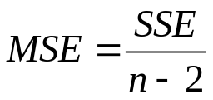
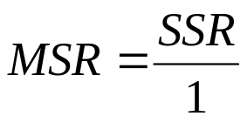
Mean Squares
A sum of squares divided by its associated degrees of freedom is called a mean square.
Recall, we estimate the variance by the error mean square MSE which is SSE/df(SSE)
The regression mean square is denoted by MSR and we have that

Slide 3
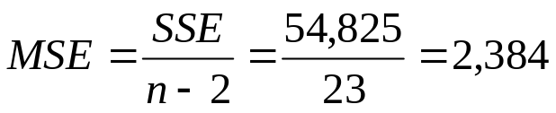
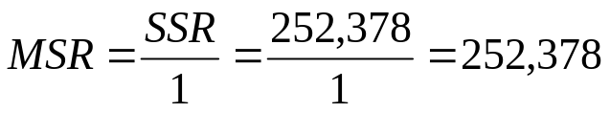
Mean Squares
For the Toluca example, we have that
Note that,
MSE + MSR = 2,384 + 252,378 = 254,762 ≠ SSTO/24 = 307,203/24=12,800
The sums of squares and the associated degrees of freedom are additive but the mean squares are not.

Slide 4
ANOVA Table
The breakdown of the total sums of squares and the associated degrees of freedom are displayed in the form of an Analysis of Variance (ANOVA) table.
The ANOVA table lists the sources of variation. For simple linear regression that is: regression (sometimes called model), error, and total.
Next to the sources of variation, the table then lists the corresponding sums of squares, df, mean squares, and the expected mean squares.
The expected value of a mean square is the mean of its sampling distribution and tells what is being estimate by the mean square.

Slide 5
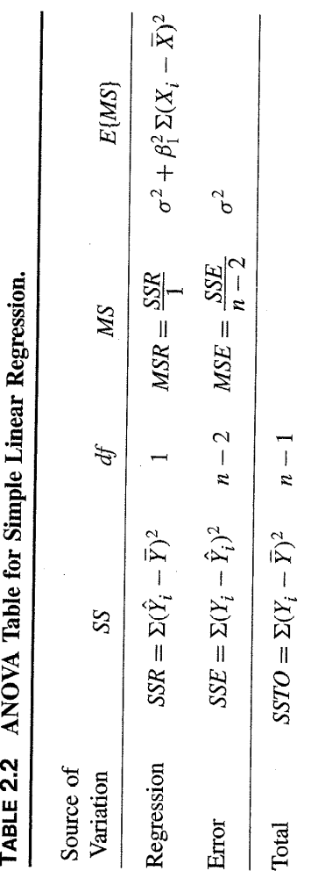
ANOVA Table
Sometimes an ANOVA table will decompose the SSTO into two parts, the total uncorrected sums of squares and the correction for the mean sum of squares.

Slide 6



ANOVA Table
We have that
We define the total uncorrected sums of squares (SSTOU) as
And we define the correction for the mean sum of squares as

Slide 7
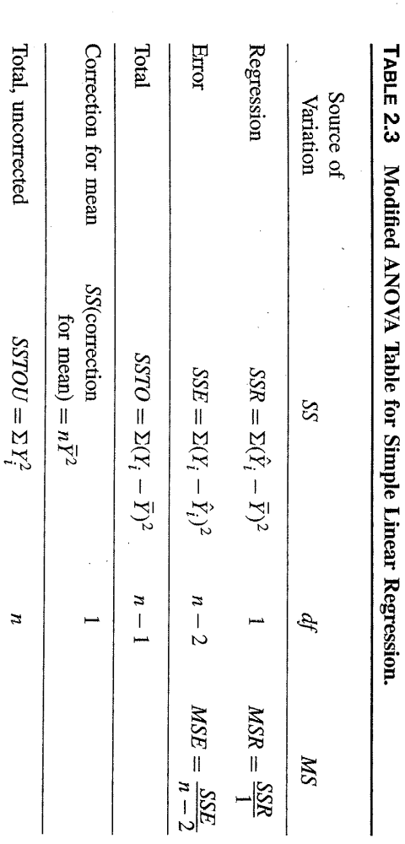
ANOVA Table
This is the general format of the modified ANOVA table. Both types are widely used but we will primarily use the basic type for this course.
The SSTO is often referred to as the corrected total sums of squares.

Slide 8
Expected
Mean Squares
In order to do inference based on the ANOVA approach, we need to know the expected value of each of the mean squares.
The expected value of a mean square is the mean of its sampling distribution and tells what is being estimate by the mean square.
For example, the expected value of the MSE is σ² and as we saw before, we use the MSE to estimate σ².
What do we know about these two values when the null hypothesis of no linear association between X and Y is true?

Slide 9
Expected
Mean Squares
Two important implications:
The mean of the sampling distribution of the MSE is σ² whether or not X and Y are linearly associated, that is whether or not β₁ = 0.
The mean of the sampling distribution of the MSR is also σ² when β₁ = 0.
Hence, when there is no linear association between X and Y, that is when β₁ = 0, the sampling distributions of the MSE and the MSR have the same mean and they will tend to be of the same order of magnitude.

Slide 10
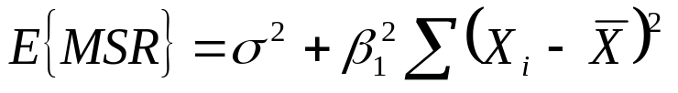
Expected
Mean Squares
However, when X and Y are linearly related, when β₁ ≠ 0, then
E{MSR} > E{MSE}.
β₁ squared is always positive and so is the sum of the squared deviations of the X’s from their mean.
Therefore, when β₁ ≠ 0 (negative or positive), the expected value of the MSR is greater than σ², and thus the MSR will tend to be larger than the MSE.

Slide 11
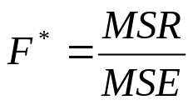
Expected
Mean Squares
Thus we can compare the MSR and the MSE to test whether or not β₁ = 0.
If the MSE and the MSR are of the same order of magnitude, this suggests that β₁ = 0.
If the MSR is substantially larger than the MSE, this suggests that β₁ ≠ 0.
This is the idea behind the F* statistic

Slide 12
F test
This F* statistic is used to test
H_{o}: β₁ = 0 vs H_{a}: β₁ ≠ 0
Recall, when β₁ = 0, then E{MSR}=E{MSE} and thus E{F*} =1.
When β₁ ≠ 0, then E{MSR} > E{MSE} and thus E{F*} >1.
Thus large values of F* are evidence against the null, so we use an upper-tail test. Note, really we are testing
H_{o}: E{F} = 1 vs H_{a}: E{F} > 1

Slide 13
F test
In order to test the hypothesis we need the sampling distribution of F*, under the assumption that the null hypothesis is true.
To determine this sampling distribution, we will use Cochran’s Theorem.

Slide 14
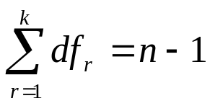
F test
Cochran’s Theorem: If all n observations Y_{i} come from the same normal distribution with mean μ and variance σ², and SSTO is decomposed into k sums of squares SS_{r}, each with degrees of freedom df_{r}, then the SS_{r}/σ² terms are independent X² variables with df_{r} if
Note that we have decomposed SSTO into two sums of squares SSR and SSE and that their degrees of freedom add to n-1.
Also, when β₁ = 0, all Y_{i} have the same mean μ= β₀ and the same variance σ². Thus when the null is true, SSE/ σ² and SSR/ σ² are independent X² variables.

Slide 15
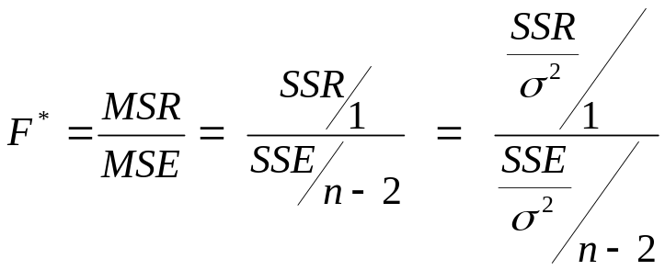
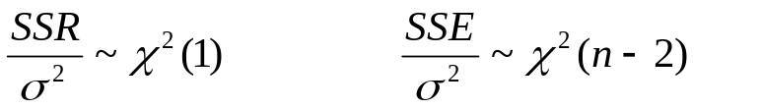
F test
Now consider F*, dividing the top and bottom by σ², we have
By Cochran's Theorem

Slide 16
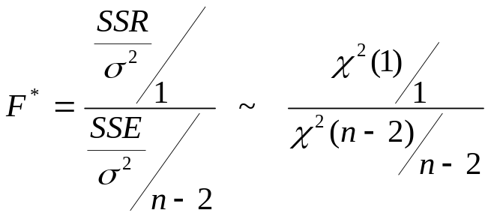
F test
Therefore, under the assumption the null is true, we have that
Therefore, when the null is true, F* is the ratio of two independent X² variables, each divided by its degrees of freedom.
This is the definition of an F random variable, so we have that, under the null, F* follows a F distribution with degrees of freedom 1 and n-2.

Slide 17
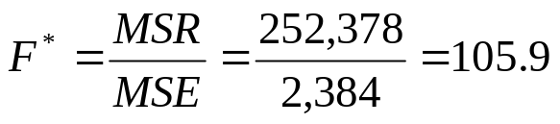
F test
Since we are using an upper tail test and F* is distributed F(1,n-2) under the null, the decision rule for an α level test is
If F* ≤ F(1-α;1, n-2), fail to reject H_{o}
If F* > F(1-α;1, n-2), reject H_{o}
Consider the Toluca example. F(.95;1,23) = 4.28. We have that MSR=252,378 and MSE=2,384. Thus
Since F* = 105.9 > 4.28 = F(.95;1,23), we reject the null.

Slide 18

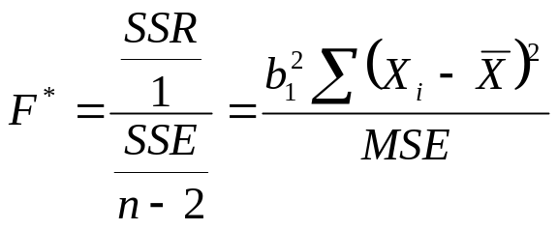
F test
The F test of H_{o}: β₁ = 0 vs H_{a}: β₁ ≠ 0 is equivalent to the two-tailed t-test testing the same hypotheses.
Note that
So we have that

Slide 19
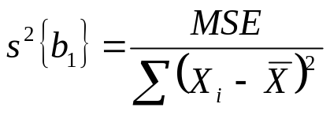
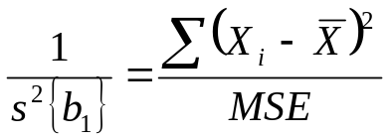
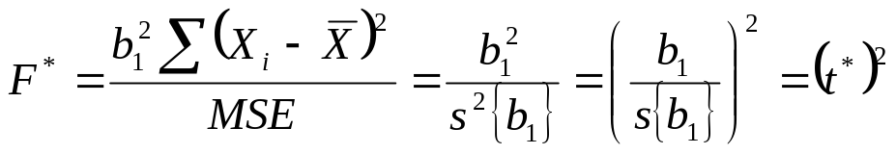
F test
Since,
We have
So we obtain

Slide 20
F test
In the Toluca example, we had that t*=10.29.
We just calculated that F*= 105.9 which is equal to (10.29)².
SAS (anova table)

